Slide 1
Explaining the variability of C. difficile disease severity in patients using mice and math: a collaboration between Systems Biology centers

Slide 2
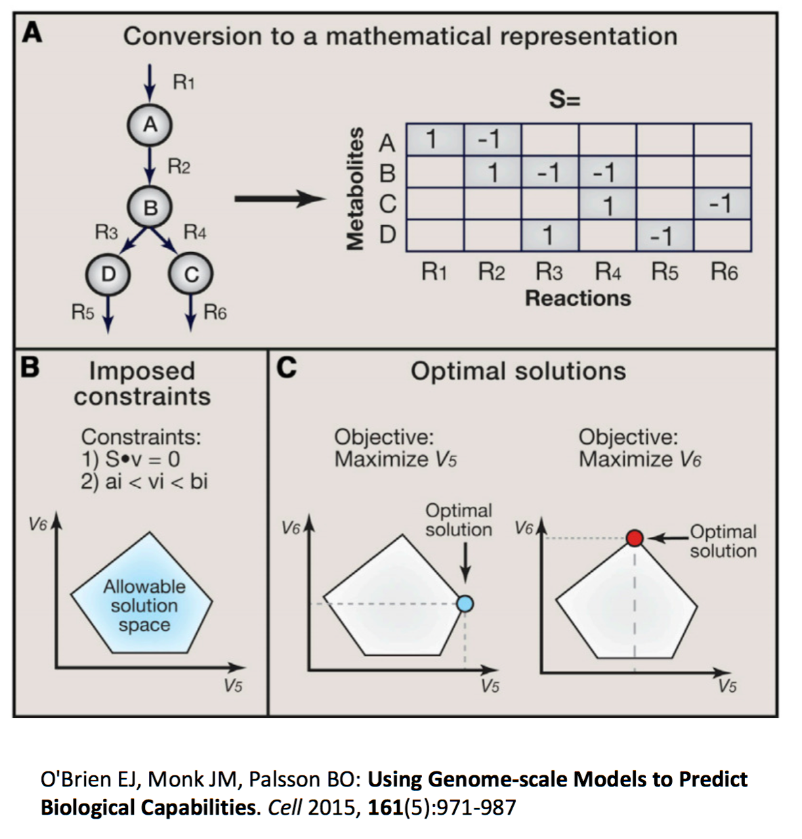
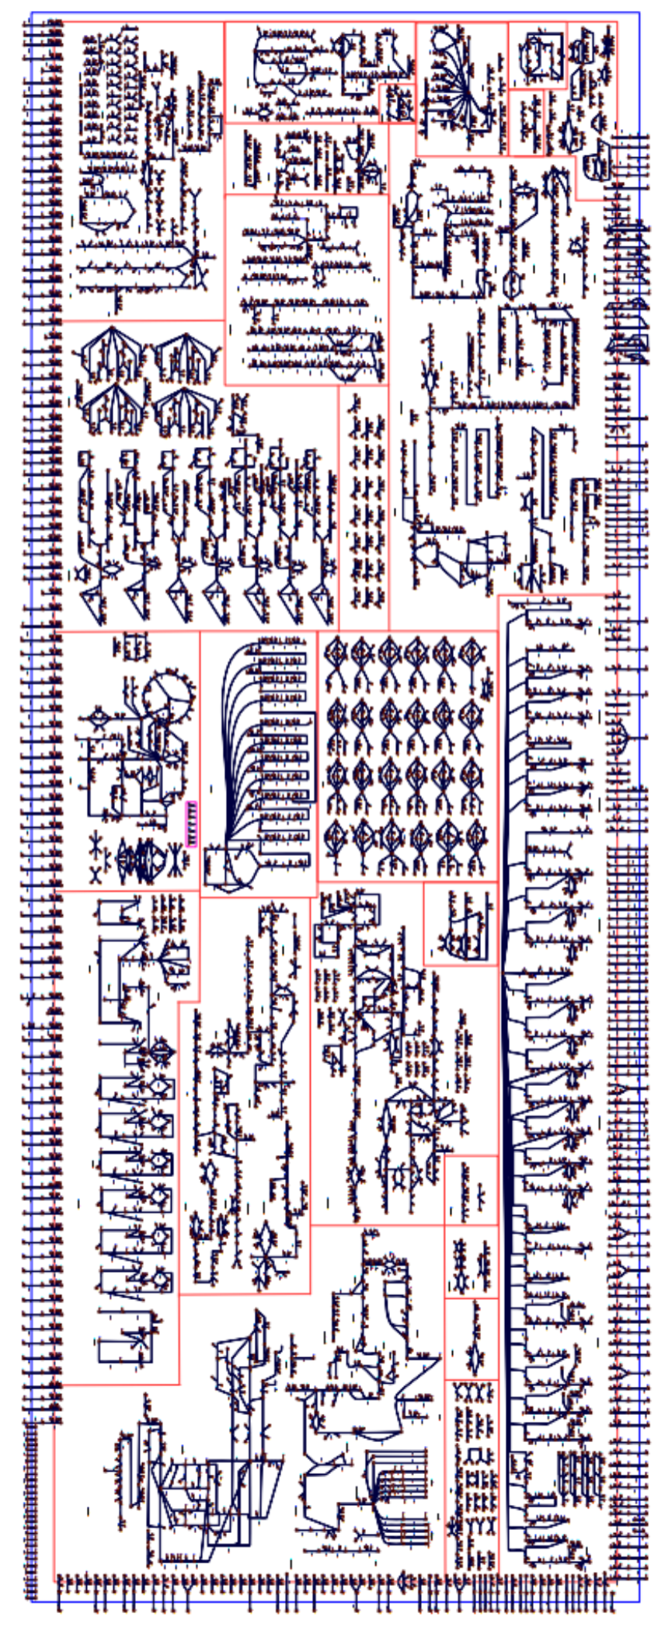
Whole genome reconstruction models are extensive knowledge bases derived from microbial genomes, literature and data

Slide 3
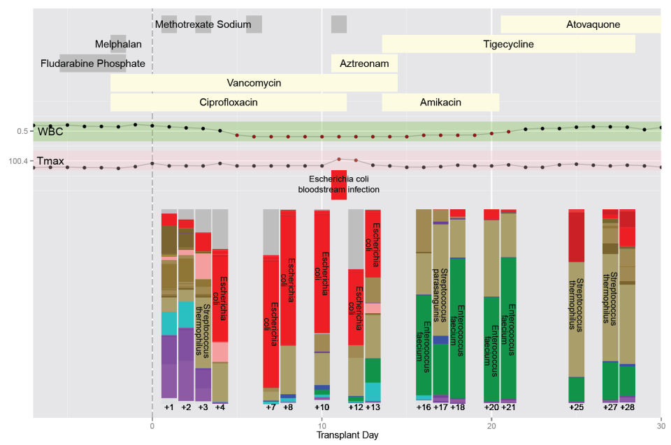
At MSKCC we study AMR directly in patients receiving bone marrow transplantation

Slide 4
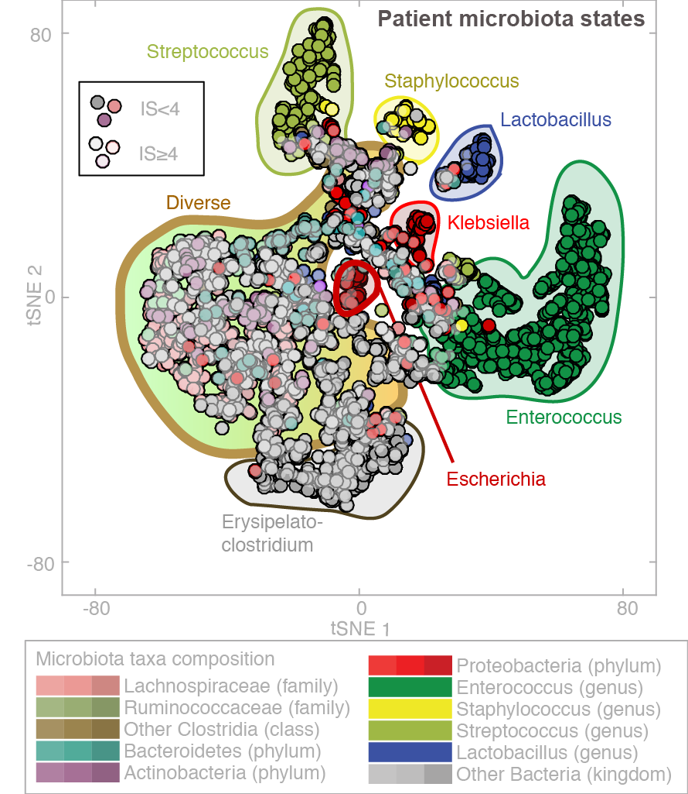
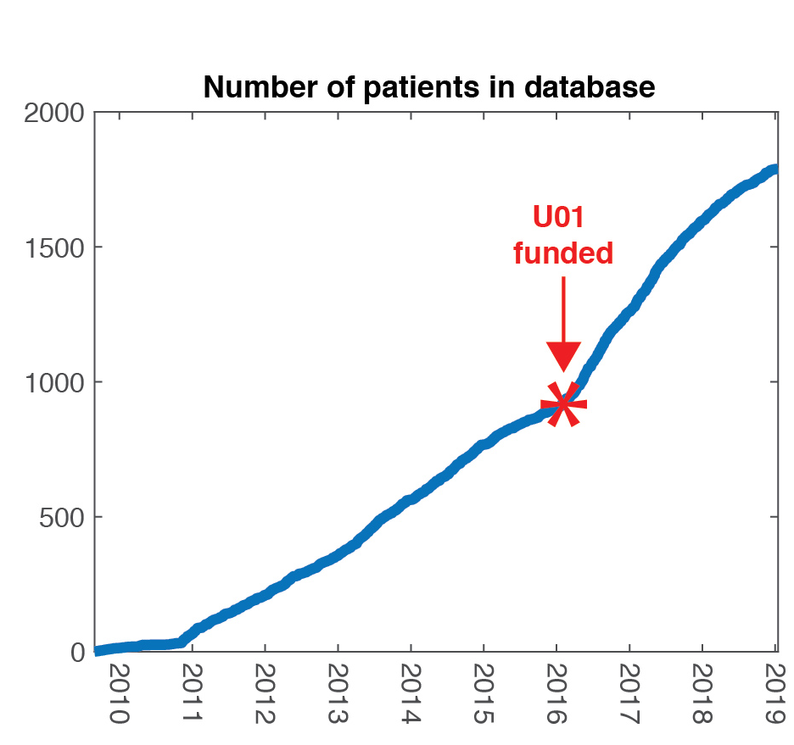
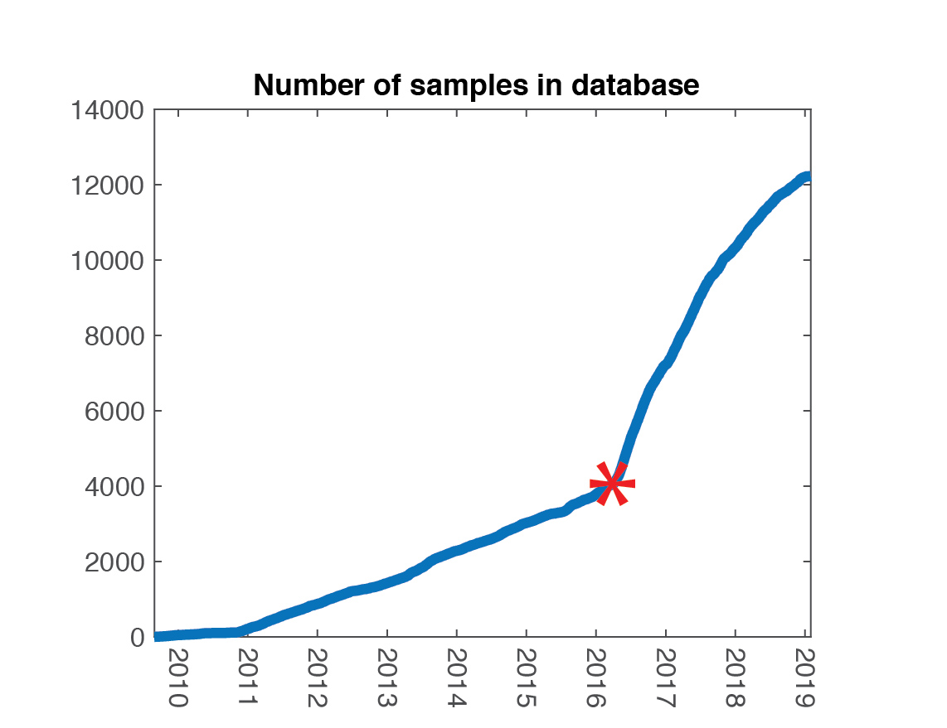
Studying microbial disease in patients requires Big Data

Slide 5
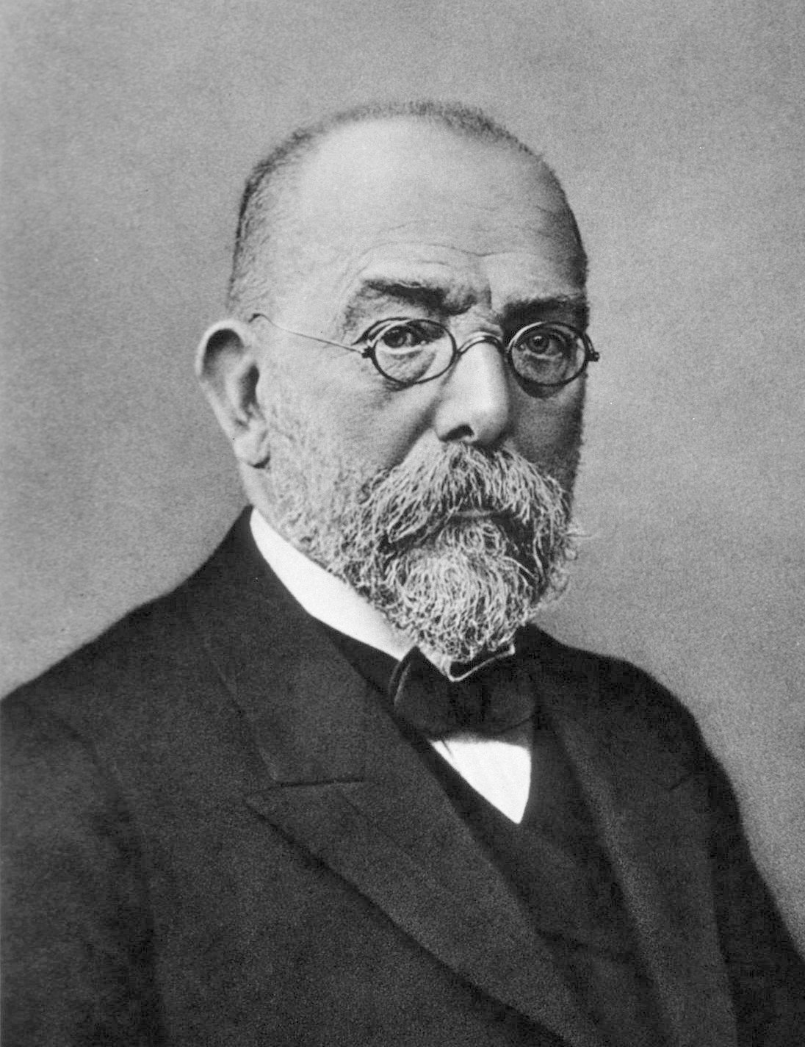
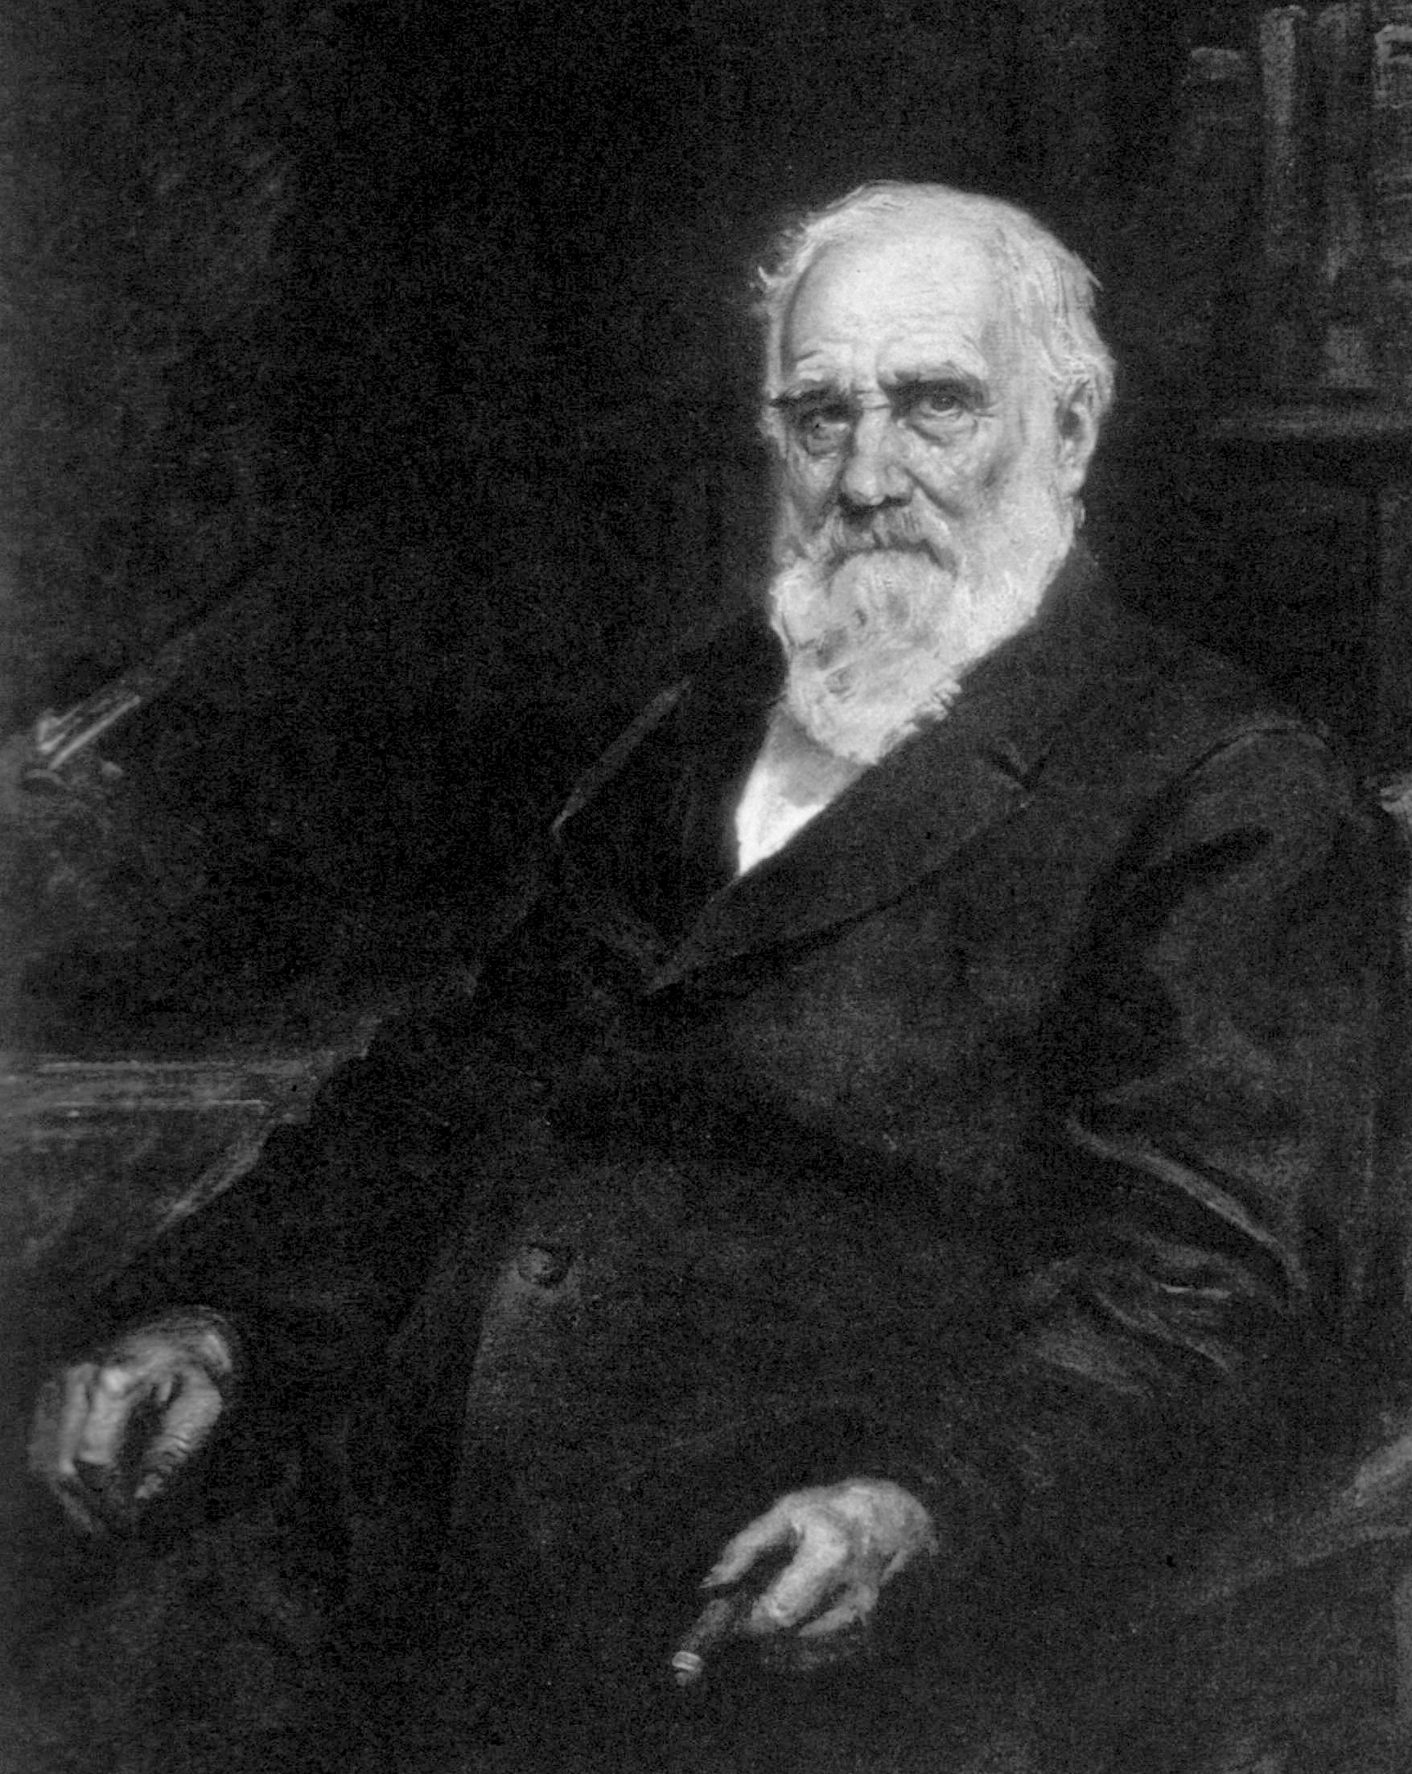
Robert Koch
Max Joseph Pettenkofer

Slide 6
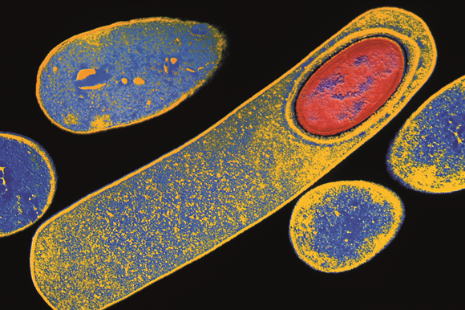
C. diff causes severe intestinal infection
Bacillus difficilis (Hall & O'Toole 1935)
Clostridium difficile (Prévot 1938)
Clostridioides difficile (Lawson 2016)
Source: Dr Kari Lounatmaa / Science Photo Library

Slide 7
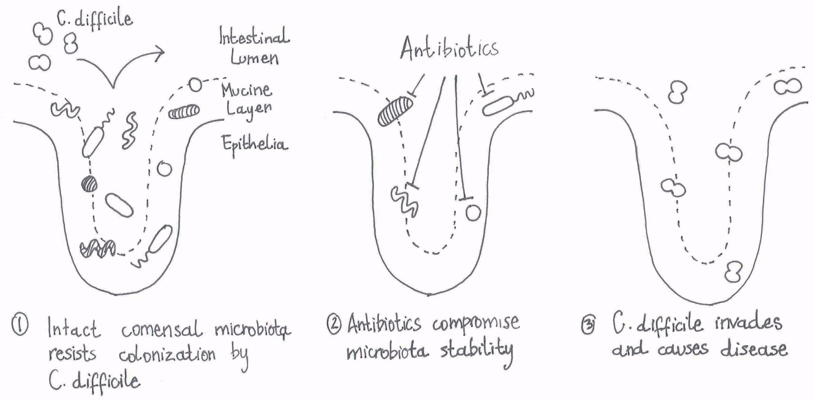
C. diff infection may depend on microbiota composition
Xavier JB, “Sociomicrobiology and pathogenic bacteria” Virulence Mechanisms of Bacterial Pathogens (2016) ASM Press

Slide 8
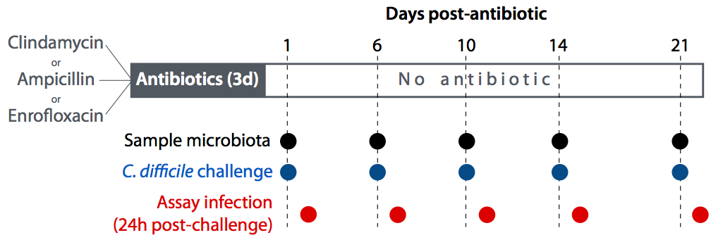
Studying role of microbiota composition in mice
Buffie et al “Precision microbiome reconstitution restores bile acid mediated resistance to Clostridium difficile” Nature 2015

Slide 9
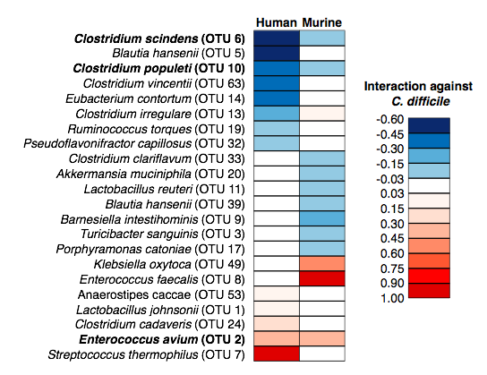
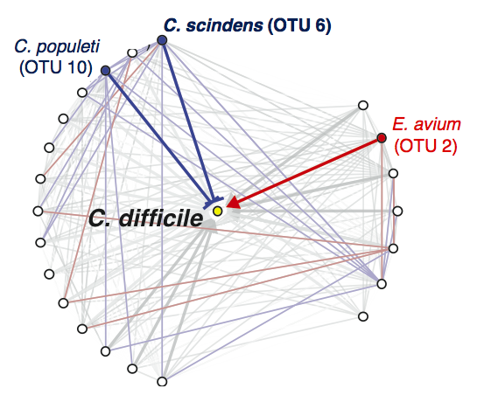
C. scindens protects mice and humans against C. diff
Buffie et al “Precision microbiome reconstitution restores bile acid mediated resistance to Clostridium difficile” Nature 2015

Slide 10
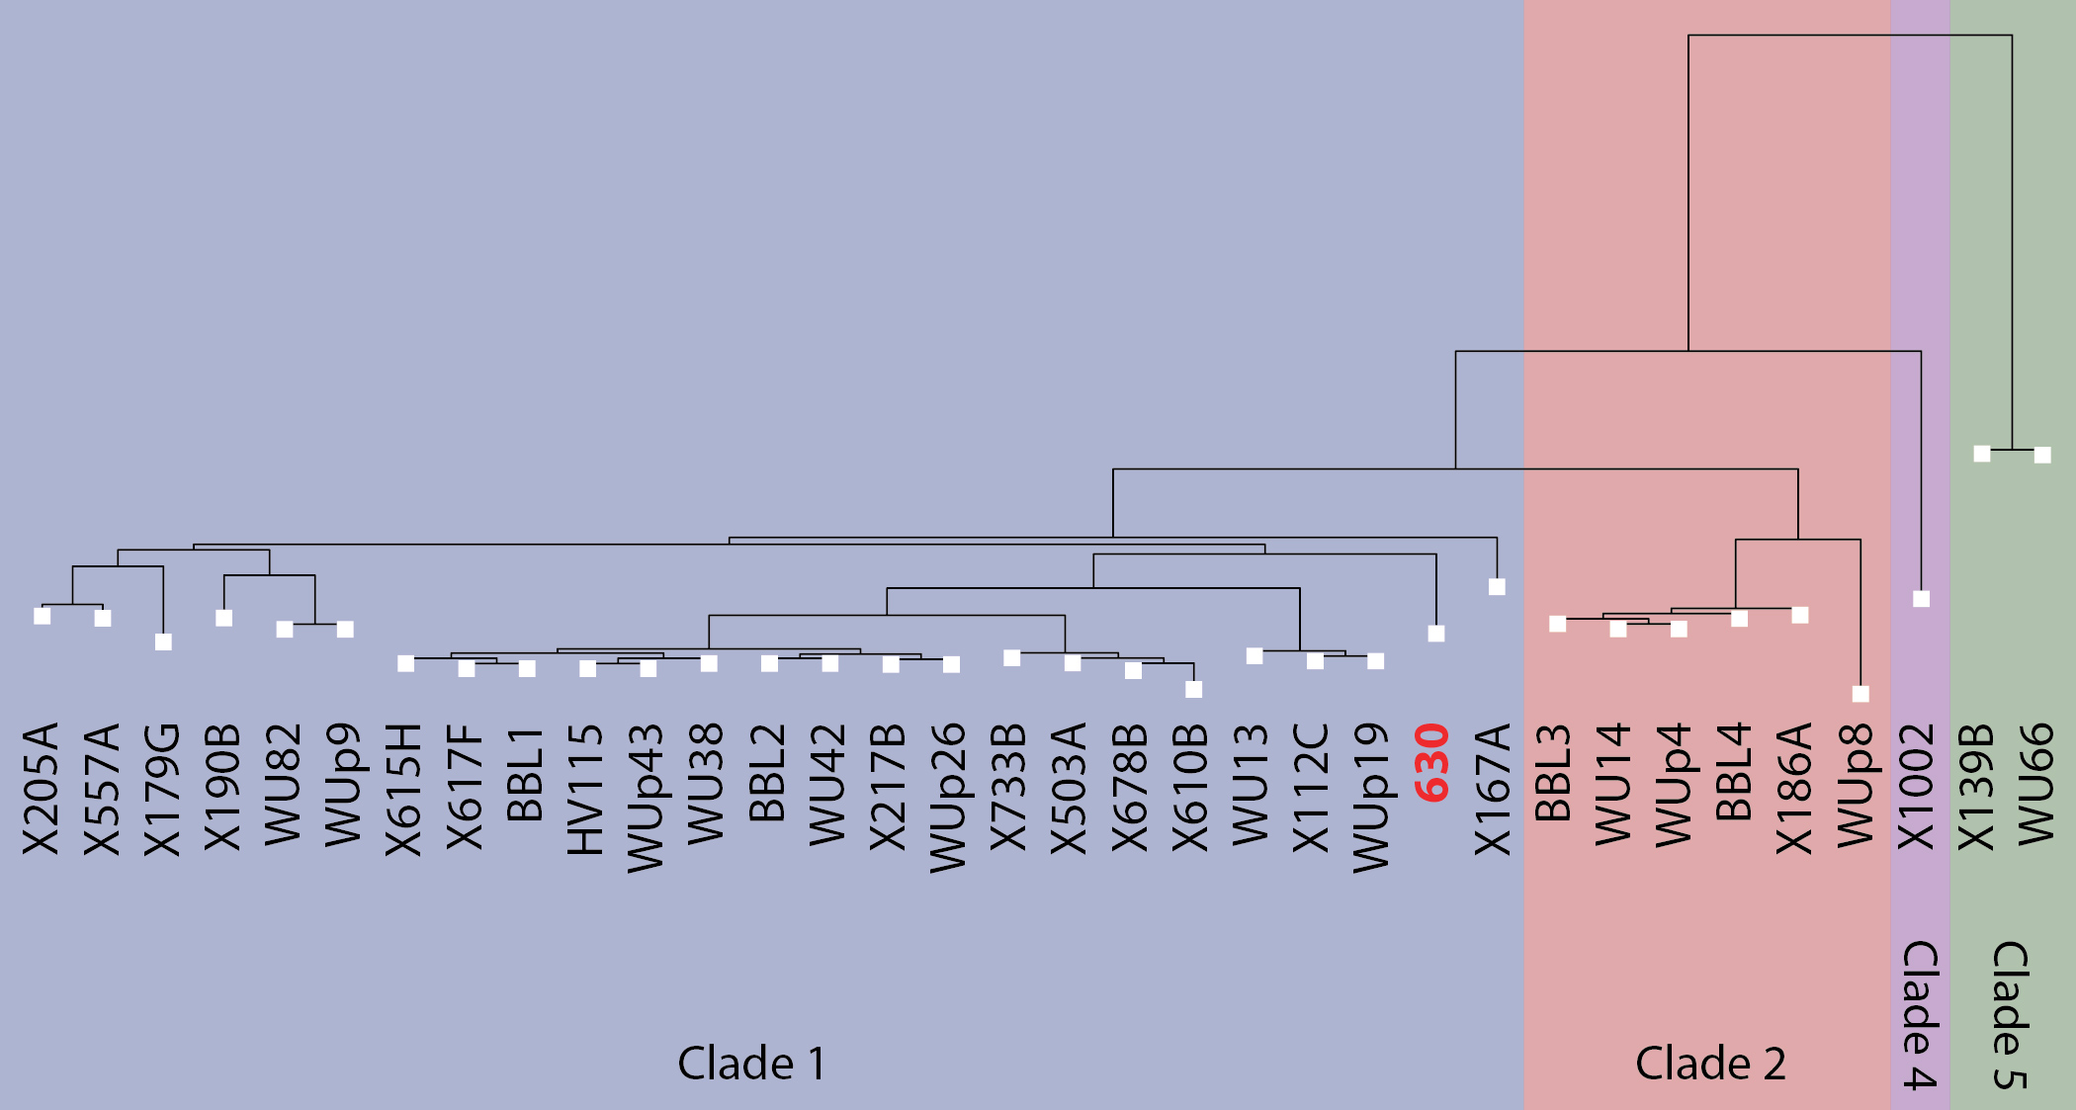
C. diff strains vary in disease severity
clade 1
clade 2
clade 4
clade 5
Lewis et al “Pathogenicity Locus, Core Genome, and Accessory Gene Contributions to Clostridium difficile Virulence” MBio 2017

Slide 11
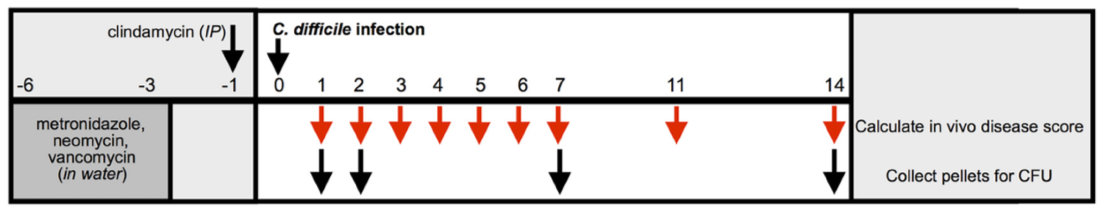
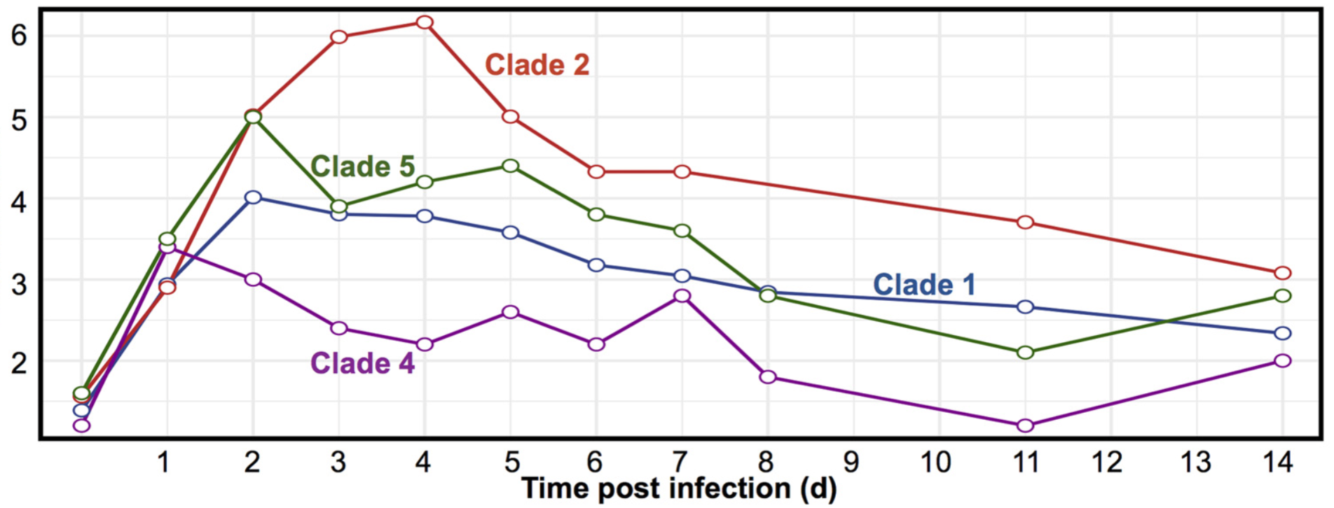
Modeling C. diff strain virulence with mice
Lewis et al “Pathogenicity Locus, Core Genome, and Accessory Gene Contributions to Clostridium difficile Virulence” MBio 2017

Slide 12
C. difficile disease severity in patients correlated with “disease score” in mouse model, not taxonomy
clade 1
clade 2
clade 4
clade 5
Lewis et al “Pathogenicity Locus, Core Genome, and Accessory Gene Contributions to Clostridium difficile Virulence” MBio 2017

Slide 13
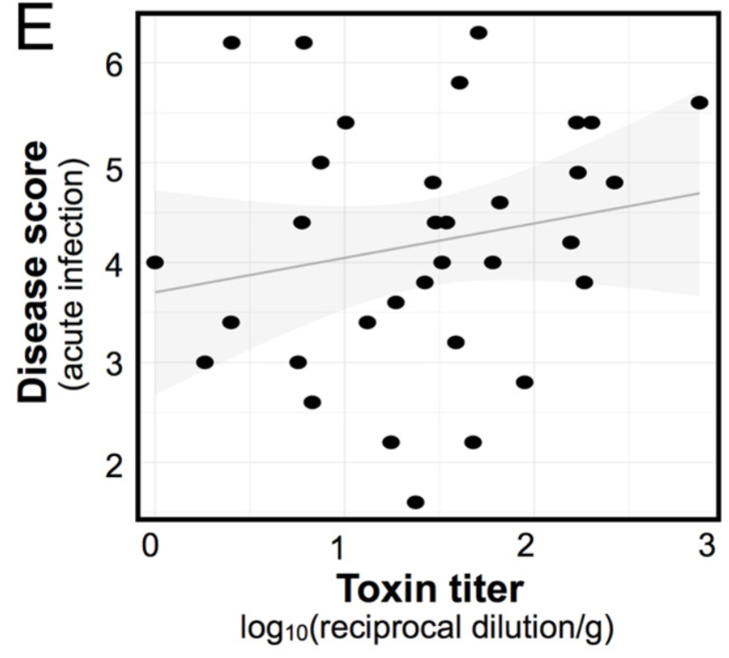
Disease score correlates weakly with toxin

Slide 14
iCN900: whole genome reconstruction of C. diff can predict growth capabilities of strains
Model of C. diff 630
(called iCN900)
UCSD center in collaboration
with Baylor Center
Flux balance analysis
(solved in Cobra-Python developed by the UCSD center)

Slide 15
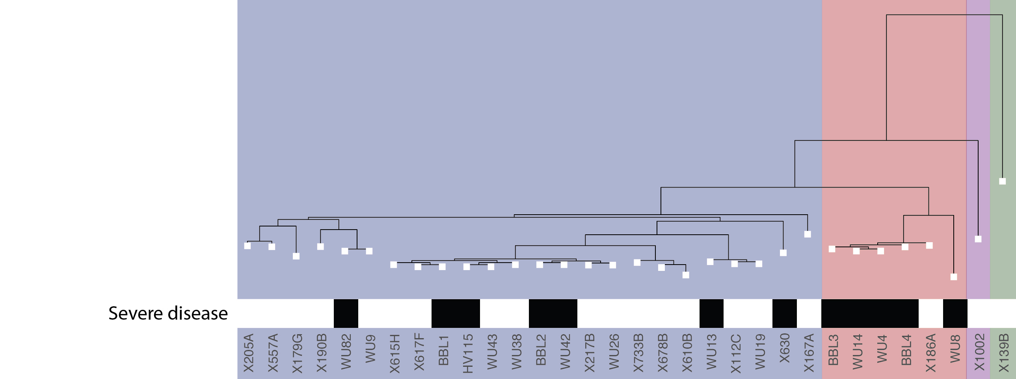
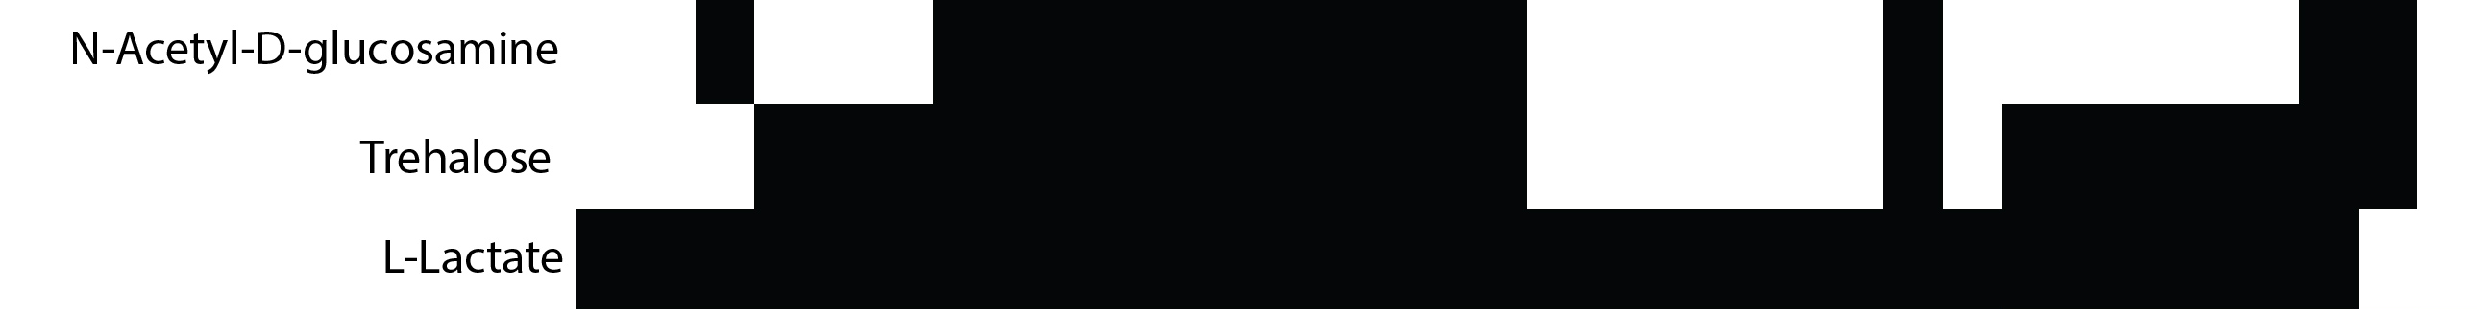
Strains differ in predicted growth capabilities in three carbon sources
clade 4
clade 5
clade 1
clade 2

Slide 16
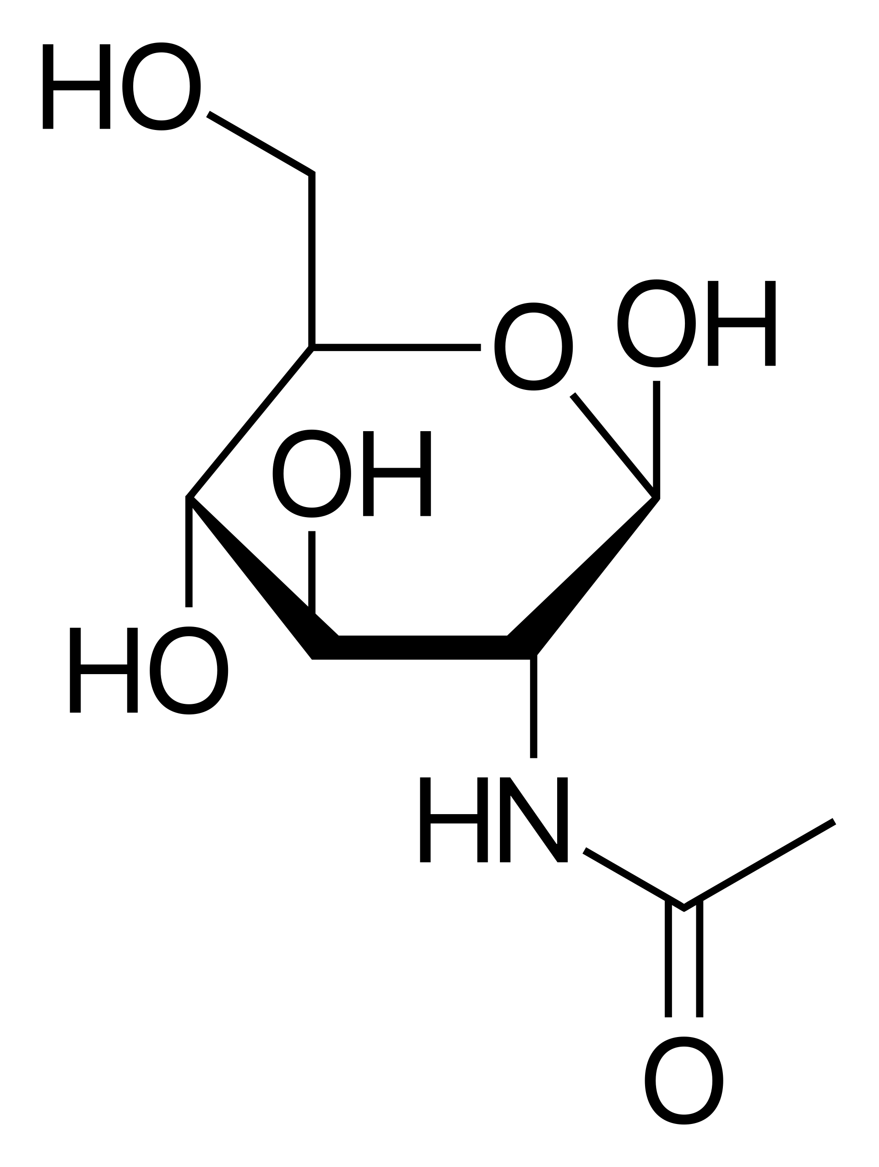
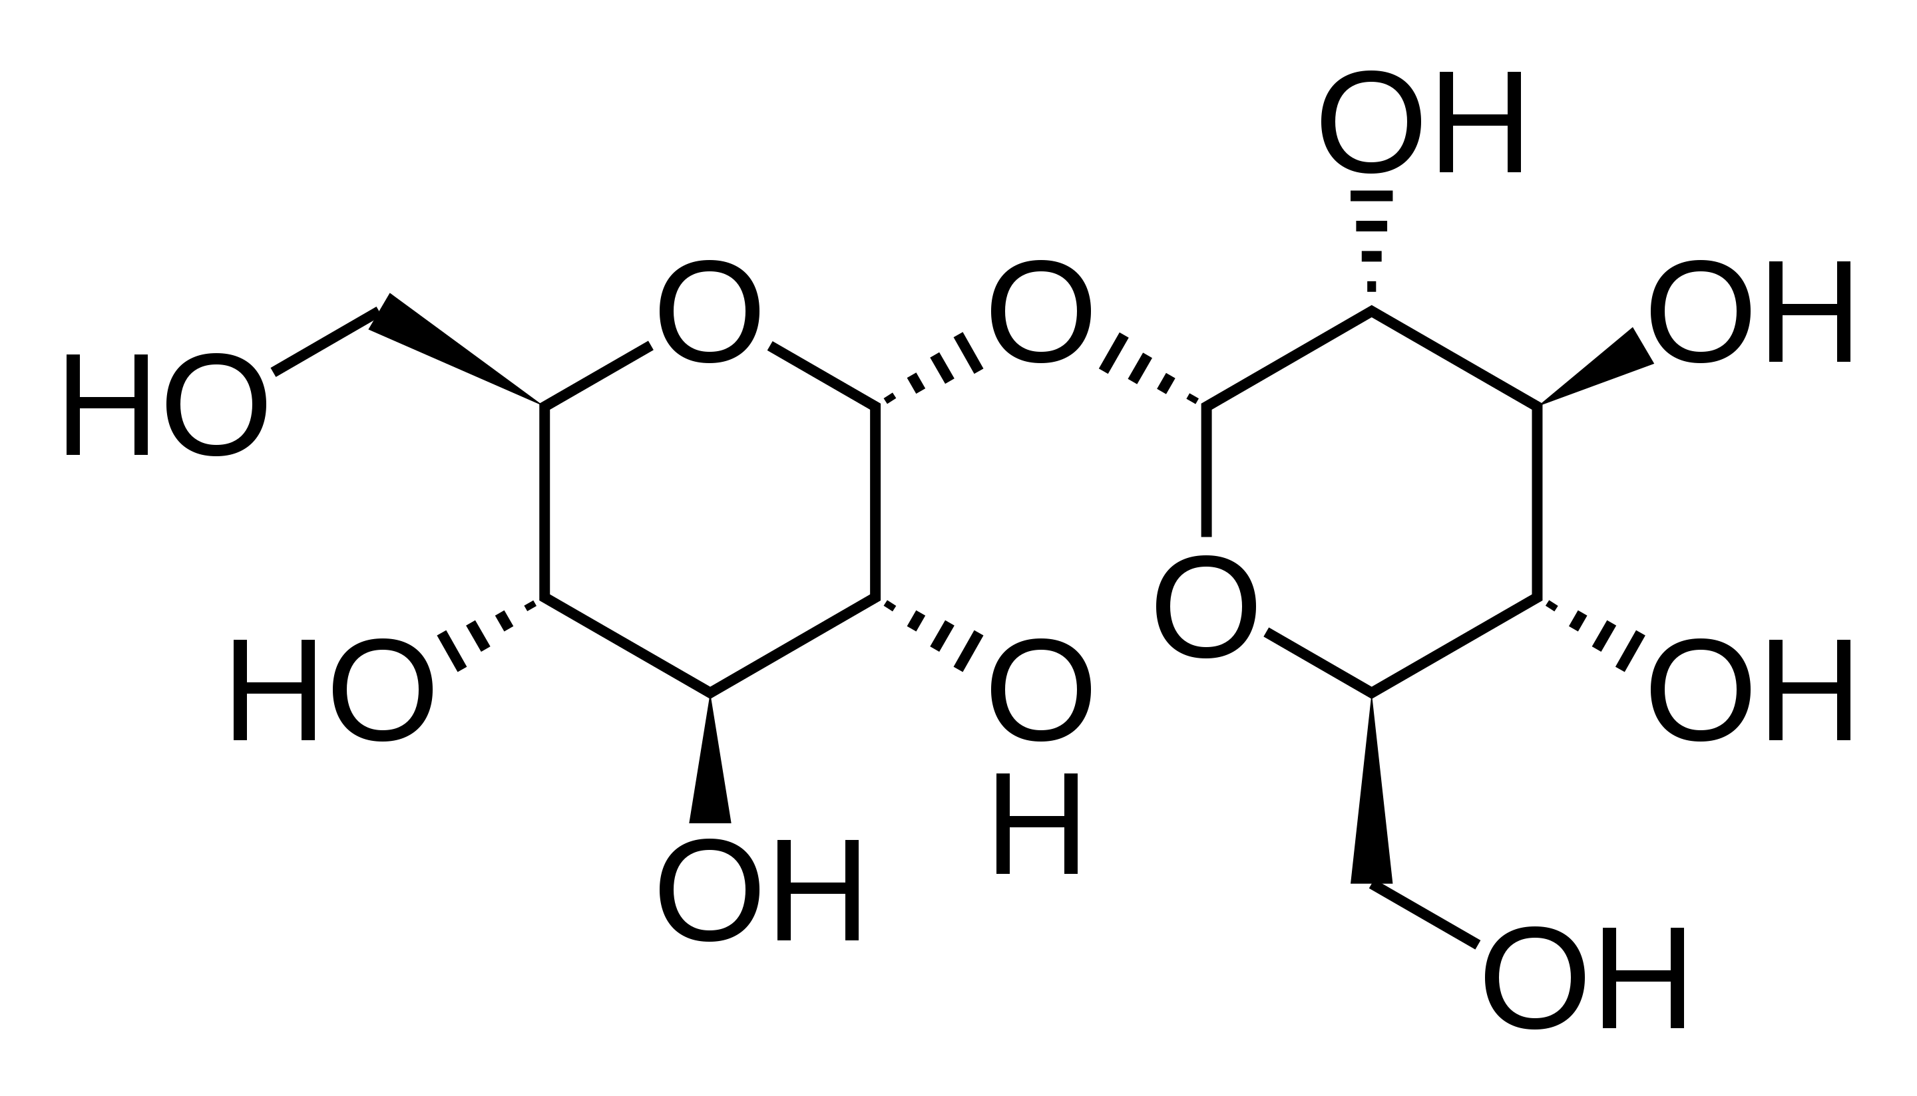
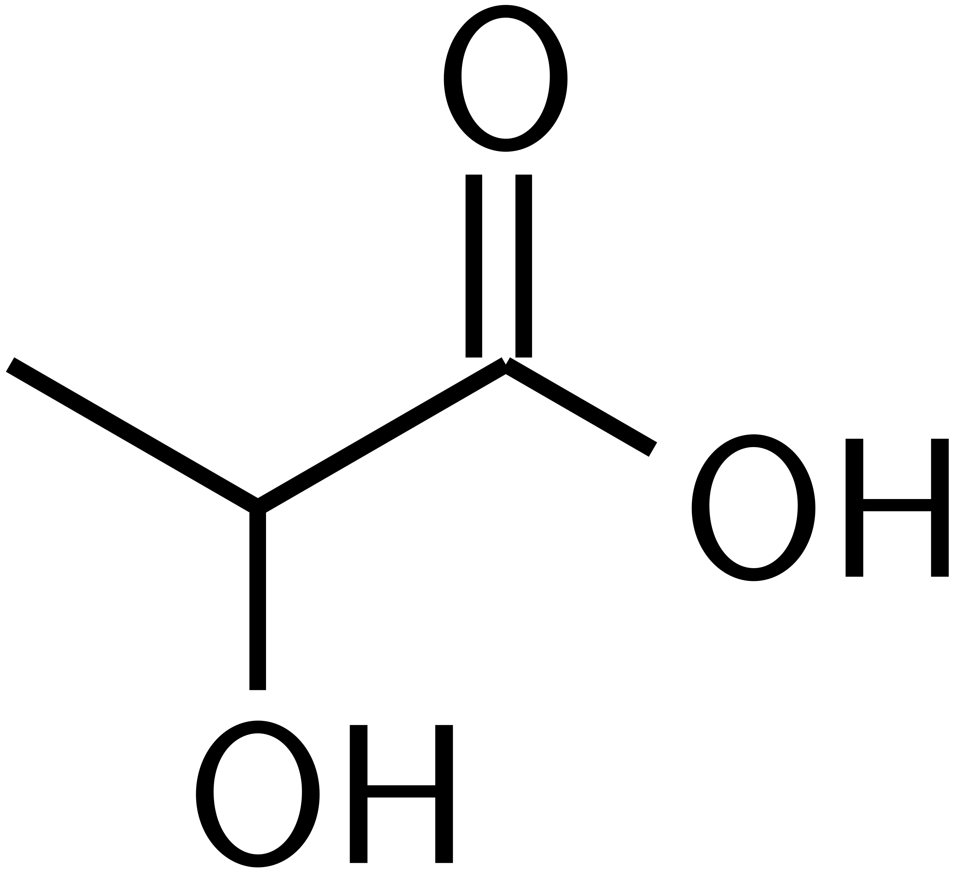
N-Acetylglucosamine:
- part of bacterial peptidoglycan
- monomeric unit of chitin
- inhibitor of elastase from polymorphonuclear leukocytes
Trehalose:
Dietary component
Enhances C. diff virulence (Collins Nature 2018)
L- Lactate:
Product of pyruvate fermentation by humans
Product of lactic acid bacteria

Slide 17
Not all traits considered virulent are really important for virulence
Strains
clade 1
clade 2
clade 4
clade 5
Phenotypes

Slide 18
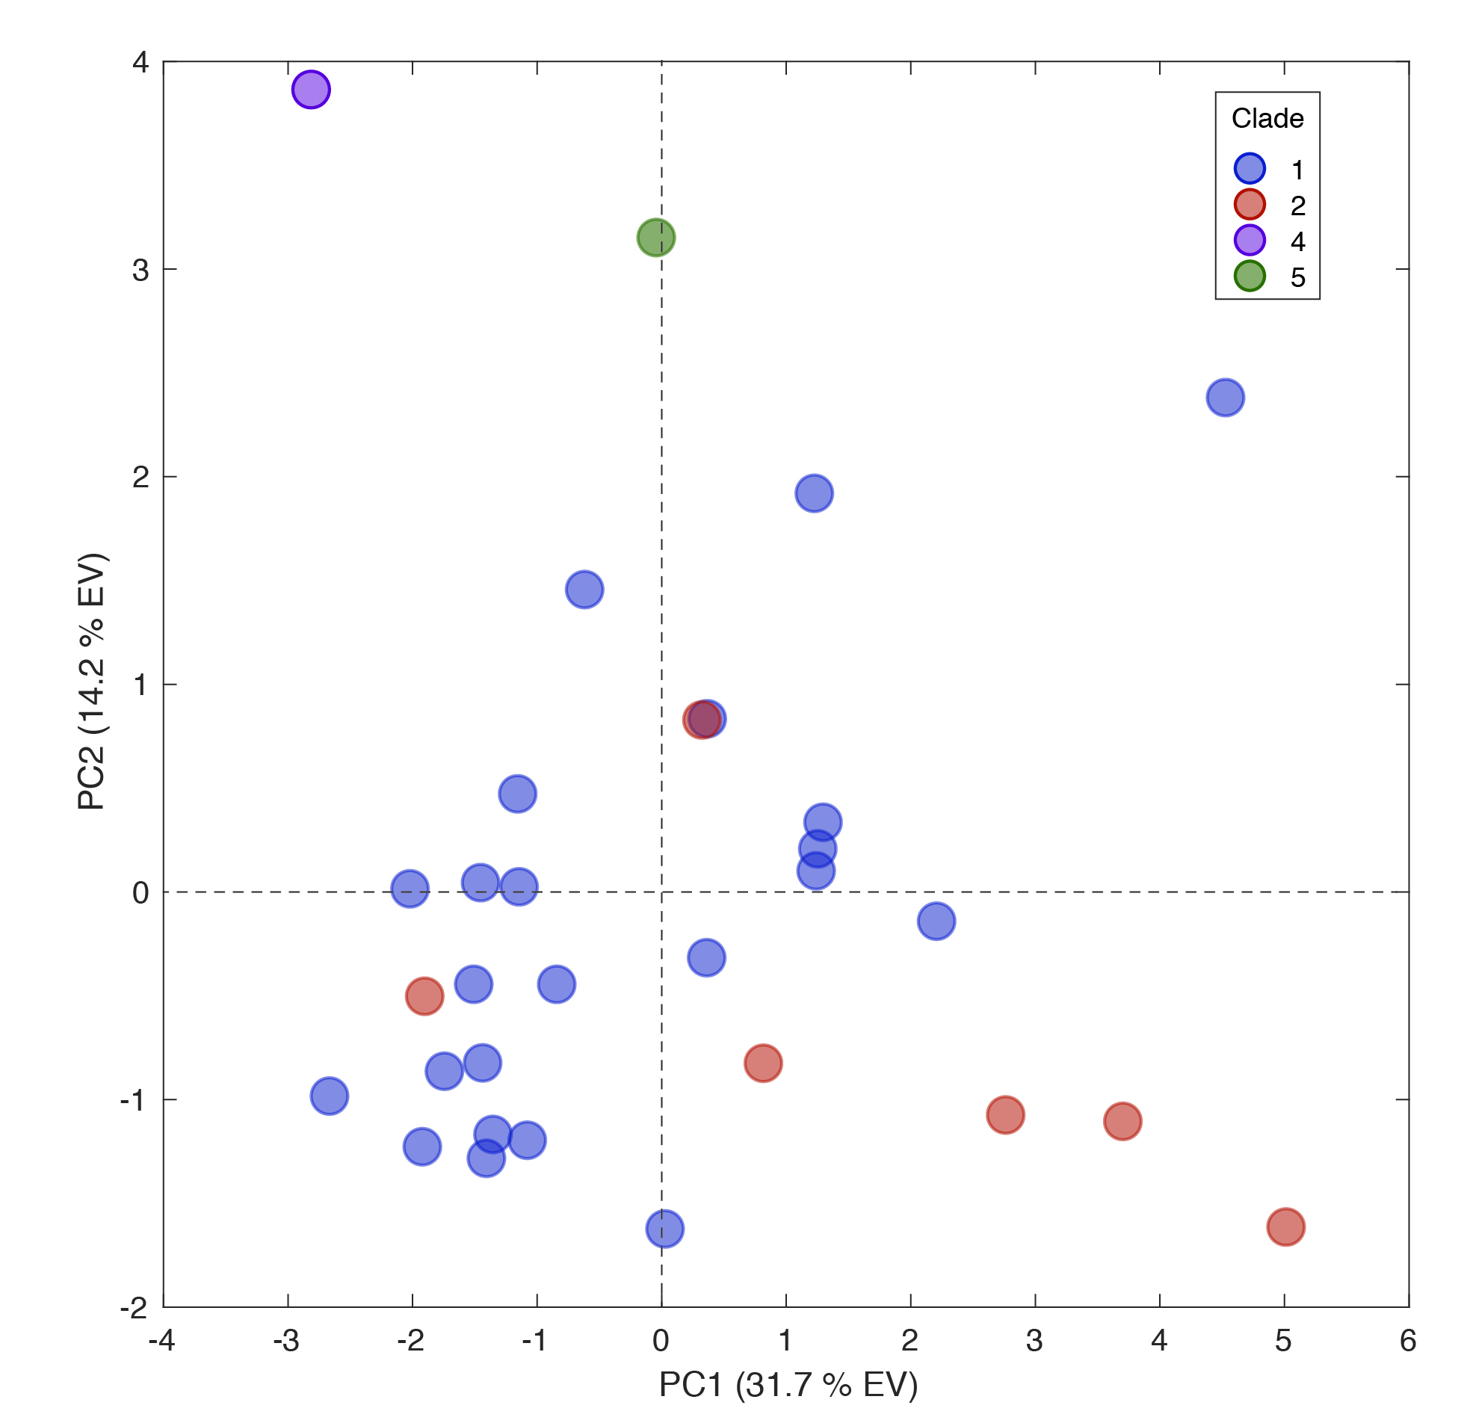
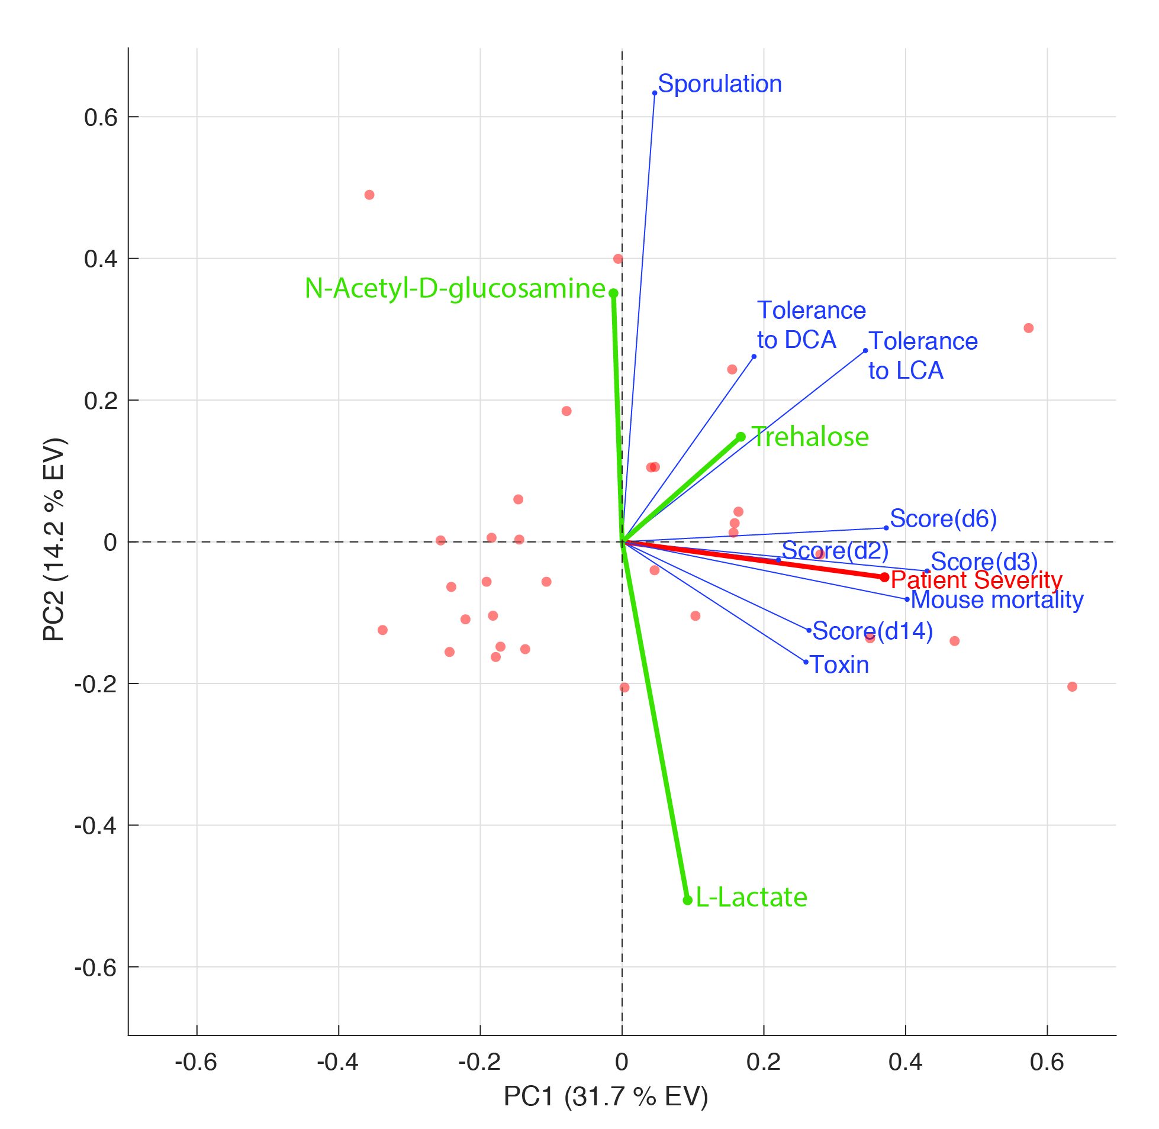
Unsupervised learning shows C. diff virulence is multifactorial and not all traits contribute equally

Slide 19
Can supervised leaning predicts disease severity in patients from C. diff traits?
Mouse virulence scores
Sporulation
LCA tolerance
Disease severity
Predicted growth
…

Slide 20
‘Feature selection’ picks C.diff traits that best predict disease virulence
% Quadratic Programming Algorithms for small number of variables
% Rodriguez-lujan, I. Quadratic Programming Feature Selection.
% J. Mach. Learn. Res. 11, 1491?1516 (2010).
%
% Code provided by Tsuyoshi Mikkaichi <tsuyoshimikkaichi@gmail.com>
% and Alexander Hoffmann <ahoffmann@ucla.edu>
AUC for toxix_d7: 0.600000
AUC for model with best features: 0.940909

Slide 21
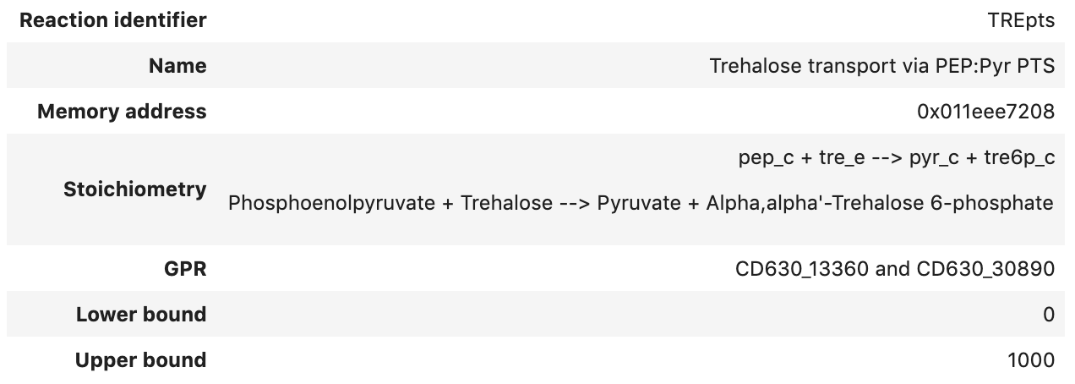
Genes unique to strains predicted to grow on trehalose
CD630_13360 | CD630_13360 | PTS system, glucose-like IIBC component | 1550494:1552071 Forward
CD630_13370 | CD630_13370 | Transcriptional regulator, RpiR family | 1552219:1552971 Forward
CD630_13380 | CD630_13380 | putative 6-phospho-beta-glucosidase | 1553110:1554450 Forward

Slide 22
Conclusions
Whole genome reconstruction model iCN900 may be adapted to strains from MSK isolates and used to predict growth capabilities
Strains predicted to differ in trehalose, N-Acetylglucosamine and L-lactate
Predicted ability to grow on trehalose correlates with patient severity and improves classifier, consistent with findings from Britton lab
Next steps
Experimentally validate growth predictions on trehalose and N-Acetylglucosamine
Refine iCN900 for Clade 2 strains.
Apply the same approach to 177 C. diff isolates from MSKCC patients sequenced at U. Michigan (of those 177, 36 lack trehalose genes)
Develop robust classifier of C. diff virulence enhanced by strain differences in metabolic capabilities

